Slide 1
i>Clicker orientation
SUMMER 2019
Notes:
September 2012

Slide 2
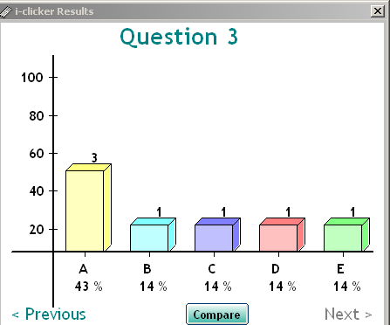
How will we use the clicker?
Questions will be presented on the screen during lectures
Use your i>clicker remote to enter your answer
Class results are tallied & can be presented in a graph on screen
Marks may be awarded correct answers

Slide 3
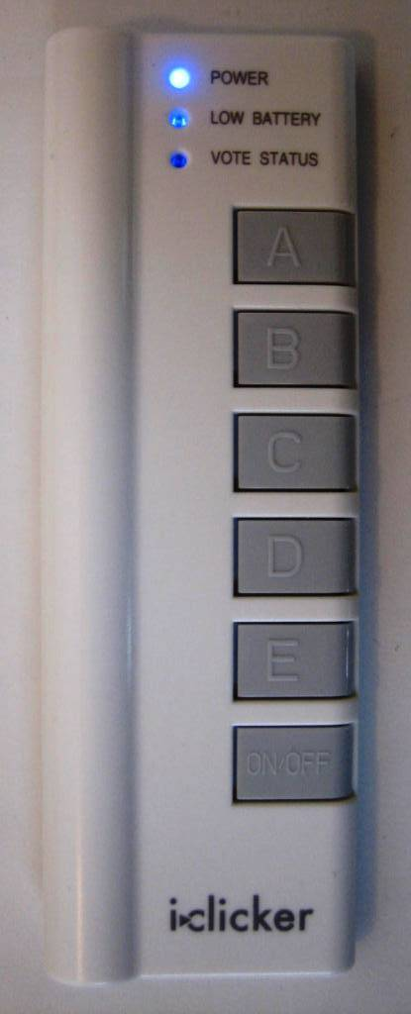
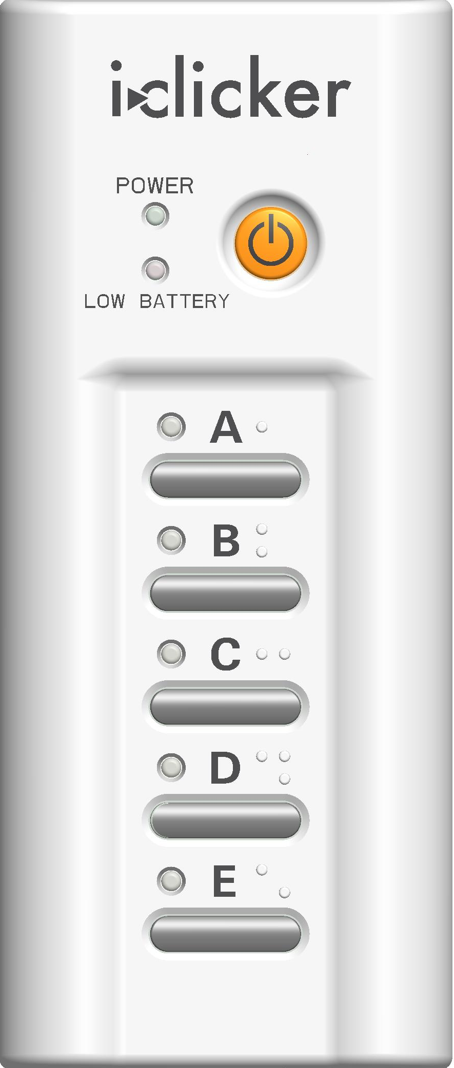
How do you vote?
Turn on the clicker using the “On/Off” button.
Check for the blue/green “Power” light at the top.

Slide 4
Changing the frequency
The frequency we’ll be using is [class freq]
At the beginning of each class,
once you see the iClicker toolbar on
your instructor’s screen:
hold the On/Off button for 2 seconds
when the blue Power Light flashes, let go
enter [class freq]
The “Vote Status” or A-E lights will turn green
after you’ve entered this new frequency
Every time you turn on your clicker
set the frequency so you can vote

Slide 5
How do you vote?
When the timer starts after a question is presented, select your answer using the keypad.

Slide 6
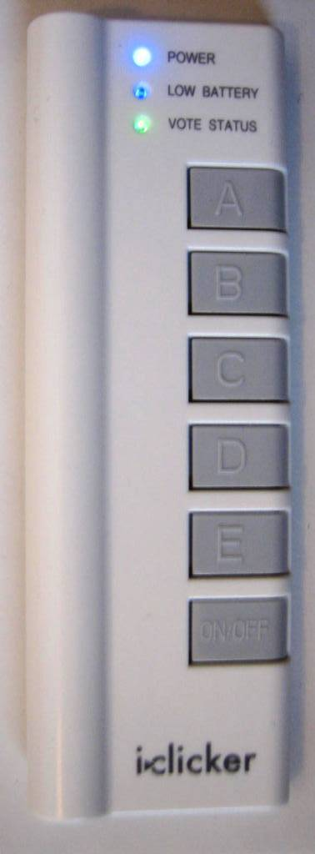
How do you know your vote was received?
Check your “Vote Status” or the “A-E” lights:
green light = your vote was sent AND received
red flashing light = you need to vote again
Not sure you saw the light?
just vote again
Want to change your vote?
as long as the timer is still going, you can vote again

Slide 7
Using your i>clicker
Question 1
I am taking this course as a(n):
A. degree requirement
B. elective

Slide 8
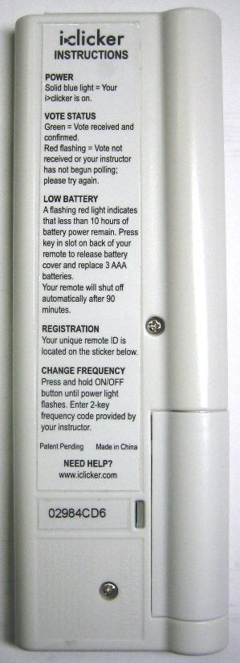
Registering your i>clicker
Until you register your i>clicker, your responses are tied to your clicker remote ID rather than to you.
Even if you’ve done the quiz, you won’t receive marks unless you’ve registered your i>clicker.

Slide 9
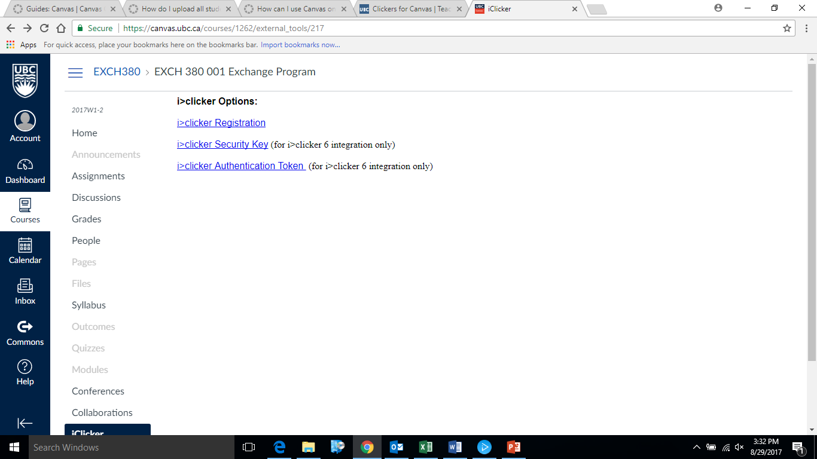
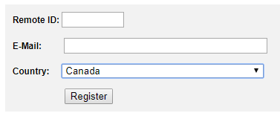
Registering Your i>clicker
Go to the your course website in Canvas.
Click on iClicker on the course menu.
Click on the Registration icon
Enter your remote ID,
email, and change the
country to Canada.
5. Click “Register”
REGISTER AT canvas.ubc.ca

Slide 10
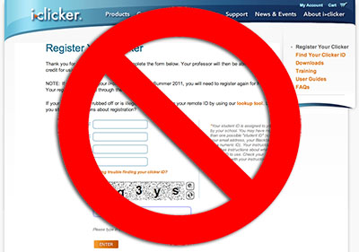
Registering Your i>clicker
Register your clicker on Canvas, NOT iclicker.com.
If you mistakenly registered at iclicker.com,
UBC will not have your clicker information.
JUST REGISTER AT canvas.ubc.ca TOO

Slide 11
What if the remote ID is illegible?
If your clicker serial number has rubbed off:
1. Look for a back up sticker in the battery compartment under the first battery.
2. Go to a special workstation in the Library and use the Clicker ID Finder program. The workstation is usually staffed by Learning & Technology Assistants and they can help if needed.
Register your clicker before the next class.
Notes:
Use the FDOC handout w/ package and leave-behind rebate info.
Student FAQS are on the iclicker website

Slide 12
Batteries
Question 2
How many AAA batteries does the remote use?
A. 1
B. 2
C. 3
Notes:
The older remotes use 3. People always forget the battery at the very top.
The newer iClicker+ remotes use 2.

Slide 13
Batteries
If you bought a used clicker, replace the AAA batteries (all 3 of them).
If you have an older model clicker, do not use Duracell (they are a bit short for the casing).
Before using a new clicker for the first time, pull the plastic tab out of the battery compartment.

Slide 14
Other important notes
All students will need to register their clicker in Canvas.
Unregister any clickers you don’t own anymore
If you lose a clicker during the semester, keep it registered so you get credit for votes sent from that clicker.
Tell your instructors if you get a new i>clicker during the term. They will need to update their class lists.

Slide 15
Other important notes
Bring your clicker to class every day!
Make sure your remote is on when voting!
Contact clicker.support@ubc.ca for help.

Slide 16
Acknowledgements
Support materials provided courtesy of i>clicker.
Adapted for use at UBC by:
The Centre for Teaching, Learning & Technology at Vancouver campus
The Centre for Teaching and Learning at Okanagan campus

